Slide 1
Edkaagmik Nbiizh Neyaashiinigamiingninwag Edbendaagzijig Trust
Presented by:
Darren Rennie, CPA, CA
Partner
Date: June 28, 2023
December 31, 2022 Audit

Slide 2
Agenda
Management Responsibility
Trustee Responsibility
Auditor Responsibility
Audit Opinion
Financial Results

Slide 3
Management Responsibility
Financial statements
Present and prepare in accordance with PSAS (Canadian Public Sector Accounting Standards)
Design and maintain accounting system and internal controls to
Ensure transactions are authorized
Safeguard assets
Properly maintain financial records

Slide 4
Trustee Responsibility
Oversee managements financial reporting responsibilities
Reviewing financial information and discussing relevant matters with management and external auditors
Approving the financial statements
Appointing external auditor
Give full and free access to information

Slide 5
Auditor Responsibility
Express audit opinion on the financial statements
Provide independent assessment to provide comfort that the Trust’s financial position is being reported correctly and spent in areas in compliance with the Trust agreement
Follow Canadian GAAS (Generally Accepted Auditing Standards)
Regulatory set of standards that outlines consistency and expectations for best practice in Canadian audits
Comply with ethical standards and properly plan and perform audit
Assess risk areas
Assess internal controls
Examine on a test basis

Slide 6
Auditor Opinions
Unqualified (clean opinion)
Qualified (not good, but not bad)
Denial (bad)
Adverse (very bad)

Slide 7
Auditor Opinions
In our opinion, the financial statements present fairly, in all material respects, the financial position of Edkaagmik Nbiizh Neyaashiinigamiingninwag Edbendaagzijig Trust as at December 31, 2022 and the results of its operations and accumulated surplus, remeasurement gains and changes in financial position for the year then ended in accordance with Canadian public sector accounting standards

Slide 8
Revenues
Includes all money received or receivable by ENNET
Dividends
Interest income
Realized gain on disposal of investments

Slide 9
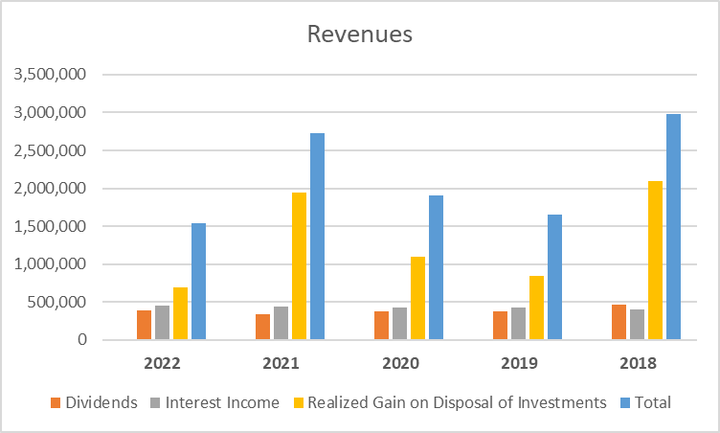
Revenues

Slide 10
Expenditures
All operating costs of ENNET
Professional fees
Foreign withholding taxes
Office and other
Trustee fees
Investment management fees
Dixon Mitchell Investment Counsel Inc.
Guardian Capital LP
Investment consulting fee
TE Investment Counsel Inc.
Trustee honoraria

Slide 11
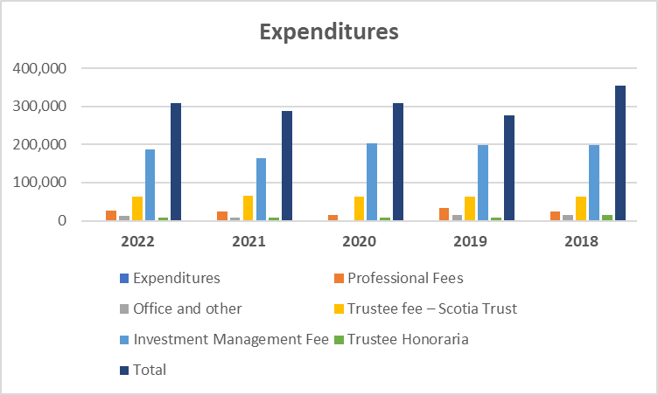
Expenditures

Slide 12
Surplus Allocation
Due to Chippewas of Nawash Unceded First Nation
Under the terms of the Trust Agreement, the Trustees must distribute the surplus income realized by the Trust each year to the Chippewas of Nawash Unceded First Nation prior to the last day of the fiscal year

Slide 13
Surplus Allocation
Due to Chippewas of Nawash Unceded First Nation
Due | 2022 | 2021 | 2020 | 2019 | 2018
Surplus | $1,225,433 | $2,434,663 | $1,591,395 | $1,380,679 | $2,627,899
Less: Approved Projects | ($979,682) | ($638,558) | ($691,486) | ($358,992) | ($1,042,163)
Less: Half of net realized gains | ($346,413) | ($973,681) | ($546,923) | ($423,110) | ($1,050,041)
Allocated surplus and payable to Chippewas of Nawash Unceded First Nation | ($100,662) | $822,424 | $352,986 | $598,577 | $535,695

Slide 14
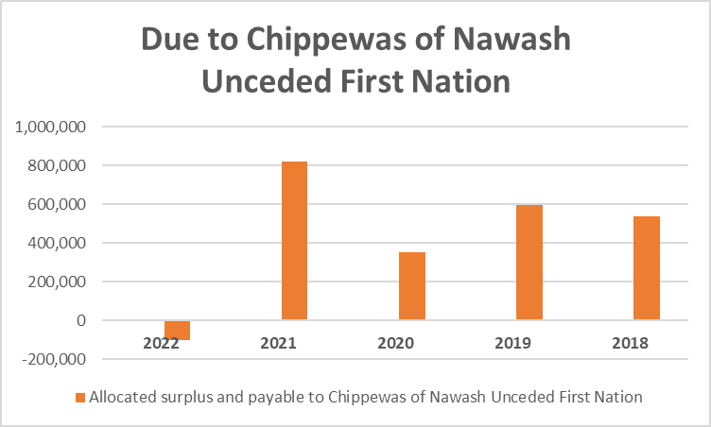
Surplus Allocation
Due to Chippewas of Nawash Unceded First Nation

Slide 15
Approved Projects
Approved Projects 2022 | 2022
COVID-19 Relief – Gift Card Initiative (300 members) | $51,000
Culture – Alaskan Wood Mill | $2,500
Culture – Jewellery Sales Travel | $1,200
Culture – Potawatomi Gathering | $78,500
Economic Development – Business Updates | $21,400
Education – Board of Education (12 students) | $180,000
Education – Costs | $2,270
Education – Traditional Medicine | $9,200
Education – Workshops | $3,800
Governance – Matrimonial Real Property Law | $80,000
Governance – UNDRIP Engagement | $50,794
Health – Cooling Unit Containers | $27,079
Health – Equestrian Team Fees | $4,647
Health – Medical costs | $53,370
Health – Goodlife Memberships (1,136 members) | $284,122
Health – Hockey Fees | $18,800
Health – Playgrounds | $100,000
Health – Medical Scooter | $2,400
Health – Soccer Fees | $5,000
Health – Team Ontario Hockey | $3,600
Total (2022) | $979,682

Slide 16
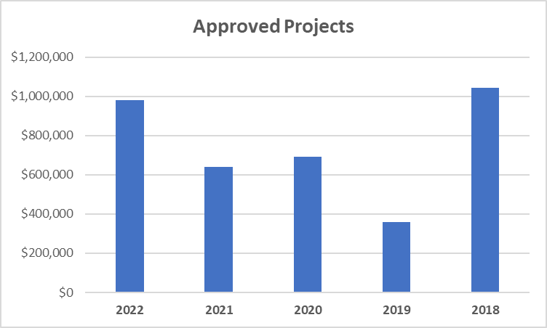
Approved Projects

Slide 17
Assets
Definition - Things that ENNET owns or has owing to ENNET that provide economic benefits
Cash
Investments
Accrued investment income receivable (Accounts Receivable)

Slide 18
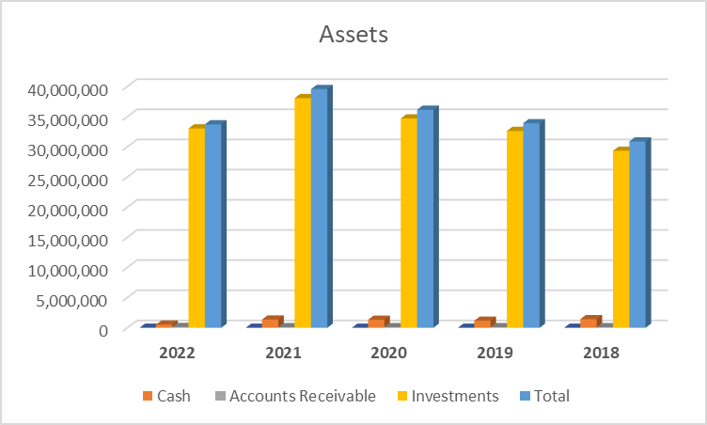

Slide 19
Liabilities
Definition - Things that ENNET owes and has to pay in the future
Accounts payable for projects and services
Due to Chippewas of Nawash Unceded First Nation
Per capita distributions payable

Slide 20
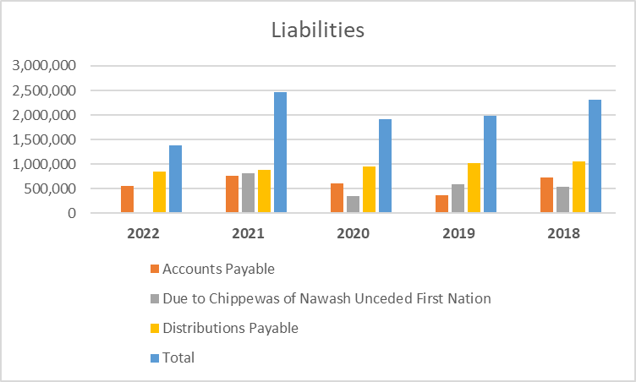
Liabilities

Slide 21
Trust Equity
Definition - Everything that ENNET owns LESS what ENNET owes (unspent wealth)
Accumulated operating surplus
Accumulated remeasurement gains

Slide 22
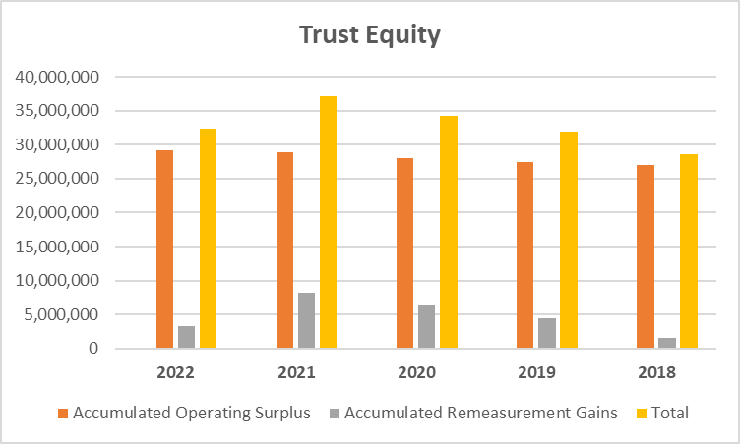
Trust Equity

Slide 23
Questions?
Darren Rennie, CPA, CA
Partner
darren.rennie@mnp.ca
519.772.2980

